Slide 1
Lecture 6: Queue and Stack
Tsung-Wei (TW) Huang
Department of Electrical and Computer Engineering
University of Utah, Salt Lake City, UT
Notes:
We have just finished the topic of circuit partitioning. Before we move on to the next stage of the physical design, floorplanning, I am going to spend three lectures talking essential data structures that we will need in implementing floorplanning algorithms. Today we are going to cover the data structure queue and stack, two of the most important data structures in all computer science problems.

Slide 2
In-class Presentation: 9/14
Circuit partition research presentation on 9/14 (in class)
George Karypis and Vipin Kumar, "Multilevel k-way Hypergraph Partitioning," 1999 ACM/IEEE DAC – presented by W-L Lee
Honghua Yang and Martin Wong, "Efficient Network Flow Based Min-Cut Balanced Partitioning," 1994 ACM/IEEE ICCAD – presented by Randy
Masahiro Tanaka, Kenjiro Taura, Toshihiro Hanawa, Kentaro Torisawa, "Automatic Graph Partitioning for Very Large-scale Deep Learning," 2021 IEEE IPDPS 2021 – presented by McKay
Instructions
Upload your pptx to https://github.com/tsung-wei-huang/ece5960-physical-design/issues/9
Template is available here: https://github.com/tsung-wei-huang/ece5960-physical-design/blob/main/Presentation/template.pptx
Notes:
This is another friendly reminder again. This wed we are going to have three students coming up to the stage presenting three research papers related to circuit partitioning. The first one is multilevel k-way …, (explain).
Make sure you upload your pptx to the issue page with the link over here. You will need to respond to the issue page and attach your power point as the attachment. Please use the template here, which can be downloaded from the class github.
Each of you should have about 20-25 min to present the motivation, contributions, technical details, and experimental results of the three papers. Basically after listening to your presentation, the audience should have a good understanding about what the paper is doing and have a rough idea about how to implement the paper to reproduce the result.

Slide 3
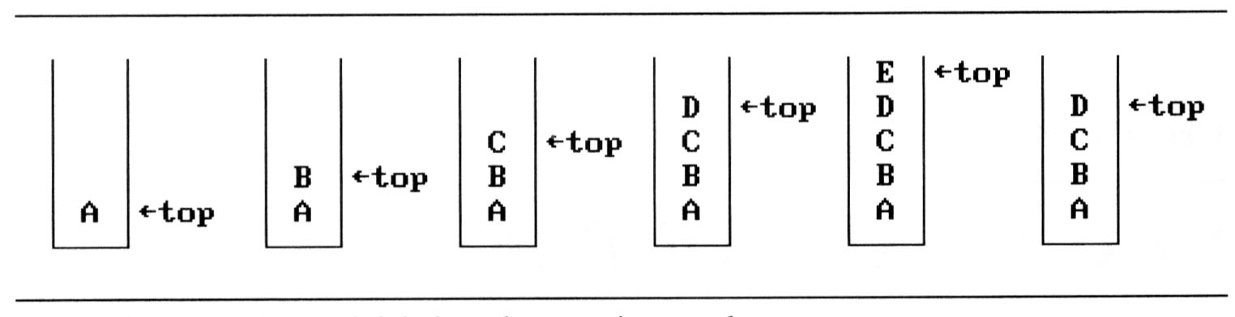
Stack
An ordered list supporting insertions and deletions
Push: push an element into the list
Pop: pop an element from the list in Last-In-First-Out (LIFO) order
If we add the elements A, B, C, D, E to the stack, in that order, then E is the first element we pop from the stack
Notes:
What is data structure? It’s the way we structure the data. The term structure means we structure or manipulate the data in certain order. Stack is one of such an example. It is an ordered list supporting insertions and deletions, defined by the two operations, push and pop. The push operation pushes an element …

Slide 4
Stack Visualization
Three main operations
Push: inserts a new item into the stack
Pop: removes the last inserted item from the stack
Top: query the top item in the stack
a₃
a₃
a₂
a₂
a₁
a₁
a₀
a₀
Push (Add)
Pop (Delete)
Notes:
Visualizing how stack works is as follows: there are three main operations, push, pop, and top. (explain..)
These operations are defined in a last in first out or first in last out order, allowing allow us to use the data structure to implement certain algorithms.

Slide 5
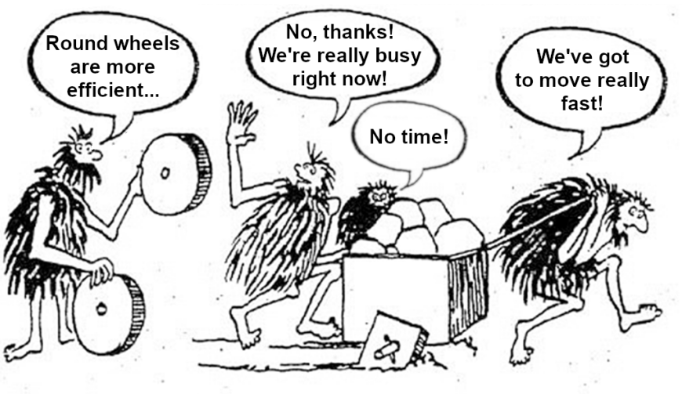
Stack Implementation in C++
Standard Template Library (STL)
https://en.cppreference.com/w/cpp/container/stack
/* stack example */
#include <iostream>
#include <stack>
int main() {
std::stack<int> stk;
stk.push(1);
stk.push(2);
std::cout<<stk.top();
/* clear the stack */
while(!stk.empty())
stk.pop();
}
Notes:
You don’t have to implement the stack data structure yourself. There is no need to reinvent the wheel, right? Because stack is a very fundamental data structure, pretty much all languages provide such a library for you to control data in a stack. For instance, in C++, the standard template library provides such a facilitate for users to organize data in a stack.
(explain the code)

Slide 6
Stack in Recursive Programs
Stack frames of recursive function call
Always returns from the last recursion
fp
al
(activation record)
fp: a pointer to current stack frame
fp
main
stack frame of invoking function
system stack before a1 is invoked
system stack after a1 is invoked
Notes:
Stack has various applications. One very fundamental application of Stack is the recursion. The definition of recursion is a function that calls itself. For instance, the famous Fibonacci number recursion. Recursion is based on stack. When you call the function yourself, it inserts a frame pointer and maintain all the recursion in a stack-based data structure, called stack frame.
During the recursive call, when you reach the bottom of the recursion, which stack frame will you return the first? The last recursive call, right? So, recursion is implemented based on stack because you always need to return from the latest or the deepest recursive call. Without stack, you cannot implement recursion.

Slide 7
Application: Parenthesis Checking
Input: a string of brackets '(', ')', '{', '}', '[' and ’]’
Goal: determine if the input string is valid
Open brackets must be closed by the same type of brackets
Open brackets must be closed in the correct order.
Note that an empty string is also considered valid.
A very frequently asked question in job interview
() | valid
()[]{} | valid
(] | invalid
([)] | invalid
{[]} | valid
Notes:
Another super important application of stack is the parenthesis checking problem. In this application, you are given a string of brackets, round brackets, curly brackets, and square brackets. Your job is to determine if the input string forms a valid parenthesis. An input string is valid of parenthesis if (explain…).
For example, the table here shows five examples of valid and invalid strings of parentheses. On the first row here, I have an opening round bracket immediately followed by a closed round bracket. Apparently, this is a valid parenthesis because it satisfies the condition we have here. (explain …)
This is a very frequently asked interview questions. I still remembered when I took the interview with two sigma, a financial firm based on New York, in 2020, this is the question I was asked during the first round of the phone interview.

Slide 8
Importance of Parenthesis Checking
A fundamental routine in language compiler
Need to parse a valid mathematical expressions
(3+2)*4*((9-6)/6)
(double)(1)/(2+7)
Need to parse a valid code block
int main () { return 0; }
void function() {}
auto lambda = [] () { my_work(); }
Many applications in physical design (e.g., floorplan)
Notes:
You probably can already tell why this is a frequently asked interview question. It is a fundamental routine in many important computer science problems, and is also a fundamental routine in language compiler. For instance, when you finish writing a program, the first thing you need to do or your compiler has to do is to parse that program into a valid mathematical expressions. If something goes wrong, the compiler need to pop out an error to tell you to fix it. Here, I have a math expression wrapped by three groups of round brackets, 3+2 first, 9-6 first and divided by 6, and then we multiply the three results together. Or I have 2 plus 7 first and make the result a divisor of one.
Similarly, your compiler needs to parse your code into valid code blocks, such as the main function here, a custom function here, or a lambda function object here. As we are going to talk in the next next week, stack is a key routine in implementing slicing floorplain.

Slide 9
Property of a Valid Expression
A valid parenthesis string/expression must imply:
All subexpressions are valid
Notes:
Let’s take a look at how we can solve this problem using stack. First, we need to take a look at the property of a valid expression. A valid parenthesis string/expression must imply all subexpressions are valid. This is a recursive definition. Again, a valid parenthesis string implies all subexpression are valid, meaning that, for each opening bracket you can always find a closed bracket in correct order, and vice versa.
Now, this recursive definition gives you the message that this problem can be solved using stack.
Let’s take a look at an example here. I have a string of 12 brackets, and I mark each pair of valid parenthesis in a specific color. For instance, the blue one represents a valid pair of curly brackets, the red color here represents a valid round bracket pair, and so on so forth. So, all the subexpression are valid parenthesis strings, and this string is a valid expression. Our job here is to solve it computationally.

Slide 10
Recursive Validness
Remove the yellow pair
Notes:
Because of this property, we can recursive remove a pair of valid parenthesis and until we can no longer remove any of them and the string has become empty, then the entire string is correct. If something goes wrong in the middle of our process, then the string is invalid.
For example, we remove the yellow pair, a valid square bracket pair.

Slide 11
Recursive Validness
Remove the purple pair
Notes:
Then, we end up with another valid string. We remove the purple pair here, a curly bracket pair.

Slide 12
Recursive Validness
Remove the green pair
Notes:
And we end up with another valid string. Next we remove the green pair here, a square bracket pair.

Slide 13
Recursive Validness
Every subexpression is valid
Notes:
Ultimately we end up with this valid pair of curly brackets. As we can see, every subexpression is valid during the recursion.
The data structure “stack” here is important for representing this recursive structure of the problem.

Slide 14
Algorithm
Initialize a stack S.
Process each bracket of the expression from left to right.
If we encounter an opening bracket, we simply push it onto the stack. This means we will process it later, let us simply move onto the sub-expression ahead.
If we encounter a closing bracket, then we check the element on top of the stack. If the element at the top of the stack is an opening bracket of the same type, then we pop it off the stack and continue processing. Else, this implies an invalid expression.
In the end, if we are left with a stack still having elements, then this implies an invalid expression.
Notes:
The algorithm works as follows: (explain …)

Slide 15
Algorithm Walkthrough – 1
Notes:
Now let’s walk through the algorithm using this string we have seen before. Remember that we will scan the string character by character from left to right. At the first iteration, we have an opening curly bracket, therefore we will insert it into the stack, with the hope that in the future of the iterations we will be able to find a match. And, the reason why we insert it into the stack is that we are recursing it into the next level, like function call.

Slide 16
Algorithm Walkthrough – 2
Notes:
Next iteration, again, we have an opening square bracket, we will insert it into the stack, meaning that we recurse to the next level.

Slide 17
Algorithm Walkthrough – 3
Notes:
Next iteration, we have another square bracket, so push that into the stack. So far, our stack has three opening brackets. What that means is we are at a recursion of depth 3 because each time you push an element into the stack you are no different than going to another recursion level.

Slide 18
Algorithm Walkthrough – 4
Notes:
Next iteration, we reach a closed square bracket, meaning that we need to stop the current iteration, right? Because it is a closed square bracket, we have to stop the recursion to the previous level and see if we are able to get a opening square bracket to form a valid parenthesis pair.
Looking at the stack we have right now, the top element represent the opening bracket that push us into the current recursion. If we need a valid substring of parenthesis, it has to match the one we are returning with.
Well, what do we have here, it’s an opening square bracket and matches the closed square bracket we have here. So, we will pop out that opening square bracket from the stack, meaning that we can successfully return from the third recursion, the recursion number 3.

Slide 19
Algorithm Walkthrough – 5
Notes:
Next iteration, we have an opening curly bracket, so insert it, push it into the stack.

Slide 20
Algorithm Walkthrough – 6
Notes:
Next, we have a closed curly bracket, meaning that we are returning from the recursion so we have to make sure the bracket that brings us into this recursion can form a valid match. Is it valid, well, the top element in the stack is the right opening curly bracket. So, we pope it out and move on.

Slide 21
Algorithm Walkthrough – 7
Notes:
(explain …)

Slide 22
Algorithm Walkthrough – 8

Slide 23
Algorithm Walkthrough – 9

Slide 24
Algorithm Walkthrough – 10

Slide 25
Algorithm Walkthrough – 11

Slide 26
Algorithm Walkthrough – 11
Notes:
Now, at the final iteration, we have a closed round bracket. Looking at the top element in the stack, we have the right opening round bracket, so we find a match and can pop it out without any error.
During this process, if there is any problem, such as you are not able to find the right opening bracket that matches the current closed bracket throughout the iterations, then we will just stop the process and return the invalid solution.
On the other hand, if we can successfully pass all iterations, we will return with the valid solution.
Any questions?

Slide 27
Algorithm Complexity
Time complexity: O(n)
We traverse the given string one character at a time and push and pop operations on a stack take O(1) time.
Space complexity: O(n)
We push all opening brackets onto the stack and in the worst case, we will end up pushing all the brackets onto the stack. e.g. ((((((((((.
Notes:
The time complexity of this algorithm is linear at big O n where n is the number of input string characters. It’s a linear time, very efficient, simple algorithm. We traverse the given string (explain …)
The space complexity is of course also linear at big O n where n is the number of input string characters. (explain …)

Slide 28
Variant: Longest Valid Parenthesis Substr
Input: a string of round brackets ‘(' and ')'
Goal: find the length of the longest parenthesis substring
Open brackets must be closed by the same type of brackets
Open brackets must be closed in the correct order
The entire string might be invalid but substrings are valid
What is the longest one of such a substring?
() | 2
)()()) | 4
(] | invalid
([)] (() | 2
{[]} | 2
Notes:
Now, the second part of the question is can you tell me the longest valid parenthesis substring. Given a string consisting of opening and closing round brackets, so here we only look at a single type of bracket, the round bracket, find the length of the longest valid parenthesis substring.
Input is a string of round brackets, ( and ). The goal is to find the length of the longest parenthesis. (explain …)
Let’s look at some examples in this table. (explain …)

Slide 29
Algorithm
Create an empty stack and push -1 to it. The first element of the stack is used to provide a base for the next valid string.
Initialize result as 0.
If the character is '(' i.e. str[i] == '('), push index 'i' to the stack.
Else (if the character is ')’)
a) Pop an item from the stack (an opening bracket)
b) If the stack is not empty, then find the length of current valid substring by taking the difference between the current index and top of the stack. Then update the result of maximum value.
c) If the stack is empty, push the current index as a base for the next valid substring.
3) Return result.
Notes:
One of the key things to realize about valid parentheses strings is that they're entirely self-satisfied by the recursive definition, meaning that while you can have one substring that is entirely inside another, you can't have two substrings that only partially overlap. This means that we can use a greedy O(N) time complexity solution to this problem without the need for any kind of backtracking. In fact, we should be able to use a very standard stack-based valid parentheses string algorithm with just three very minor modifications.
The idea is to store indexes of previous starting brackets in a stack. The first element of the stack is a special element that provides index before the beginning of valid substring (base for next valid string).

Slide 30
Implementation
int longest_valid_subparenthesis_string(string S) {
std::vector<int> stack = {-1};
int ans = 0;
for (int i = 0; i < S.size(); i++) {
if (S[i] == '(') stack.push_back(i);
else if (stack.size() == 1) stack[0] = i;
else {
stack.pop_back();
ans = max(ans, i - stack.back());
}
}
return ans;
}

Slide 31
Queue
An ordered list supporting insertions and deletions
Push: insert a new item into the list
Pop: remove an item from the list in a First-In-First-Out (LIFO) order
If we add the elements A, B, C, D, E to the queue, in that order, then A is the first element we delete from the queue
a₀
a₁
a₂
a_{n-1}
front
rear
Notes:
OK. That ends the part of stack data structure, a data structure to order your data elements in a first-in last-out order. Now, in contract to this order, the data structure queue organizes your data in a reversed order, first in first out. The element that got inserted into queue the earliest will be removed the first.
This data structure is very similar to our daily life applications. If you go to a, Cinemax or movie theater, you need to line up to get a ticket for the movie. It is first come first serve. That is the data structure queue.
(explain …)

Slide 32
Queue Visualization
Three main operations
Push: inserts a new item into the queue
Pop: removes the earliest inserted item from the queue
front: query the front item in the queue
a₃
a₃
a₂
a₂
a₁
a₁
a₀
a₀
Push (Add)
Pop (Delete)

Slide 33
Queue Implementation in C++
Standard Template Library (STL)
https://en.cppreference.com/w/cpp/container/queue
#include <iostream>
#include <queue>
int main()
{
std::queue<int> que;
que.push(1);
que.push(2);
std::cout<<que.front();
/* clear the queue */
while(!que.empty())
que.pop();
}

Slide 34
Practice: Implement Stack using Queue
Input: Given standard queue data structure
push: insert an element into the queue
pop: remove an element from the queue
Output: Implement stack using only one queue
stack::push: insert an element into the stack
stack::pop: remove an element from the stack
Notes:
Now, queue can do many things just like a stack can do many things for you. A very commonly asked question, again during the job interview, is that, can you implement a stack using queue? Given standard queue data structure that supports push and pop, can you use it to implement stack or to mimic the behavior of stack? In other words, can we use only queue push and queue pop to implement stack push and stack pop?

Slide 35
Practice: Implement Queue using Stack
Input: Given standard stack data structure
push: insert an element into the stack
pop: remove an element from the stack
Output: Implement stack using only one queue
queue::push: insert an element into the queue
queue::pop: remove an element from the queue

Slide 36
Summary
We have discussed two fundamental data structures
Stack organizes data in last-in-first-out order
Queue organizes data in first-in-first-out order
We have discussed application of stack
Recursive program implementation
Parenthesis checking
Both data structures are widely used in physical design
For instance, slicing-tree Floorplan will leverage stack to recover the chip area from a linear representation string
Notes:
Summary of today’s lecture.

